Slide 1
MIT ADT University
MIT FUSE
PG Diploma in Artificial Intelligence and Machine Learning
Academic Year 2021-22
Trimester – III Capstone Project
To analyze who are likely customers to leave ABC Telecom service provider
Student names : Jay Lad Rohan Gaikwad Sujit Pillai
Enrollment nos. : MITU21PGAI0001 MITU21PGAI0005 MITU21PGAI0007

Slide 2
Business requirement
In the telecom industry, customers can choose from multiple service providers and actively switch from one operator to another.
In this highly competitive market, the telecommunications industry experiences an average of 15-25% annual churn rate. Churn or churn rate measures the number of individuals or items moving out of a brand over a period.
Given the fact that it costs 5-10 times more to acquire a new customer than to retain an existing one, customer retention has now become even more important than customer acquisition.
For ABC Telecom, retaining high profitable customers is the number one business goal.
Objective
To reduce customer churn, ABC Telecom need to predict which customers are at high risk of churn. The company needs a predictive service for the prediction of leaving customers and offer them attractive benefits for retention.

Slide 3

Project architecture
Data Factory
Data Lake
Databricks
Data Lake
ML

Slide 4




Tasks
Storage – Azure Data Lake
Storage – Azure Data Lake
Model training – Azure ML
Data processing – Azure Databricks
Model validation & Evaluation– Azure ML
Result visualization – Azure ML
Best model selection – Azure ML
Deploy model as Web App – Azure ML
Data visualisation– Azure Databricks
Manual model building & prediction – Azure Databricks
Manual ML
Auto ML

Slide 5
Tasks – Manual prediction
Storage – Azure Data Lake
Storage – Azure Data Lake
Model training – Azure ML
Data processing – Azure Databricks
Model validation & Evaluation– Azure ML
Result visualization – Azure ML
Best model selection – Azure ML
Deploy model as Web App – Azure ML
Data visualisation– Azure Databricks
Manual model building & prediction – Azure Databricks
Manual ML
Auto ML

Slide 6

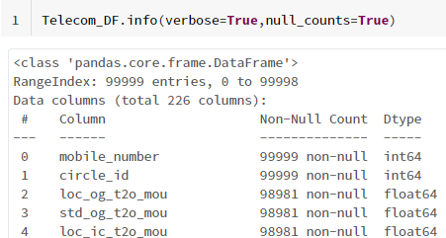

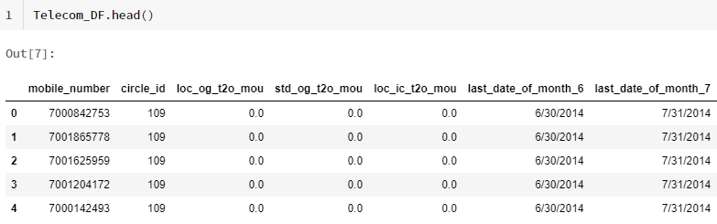
Data explanation
Real life telecom data
Data size = 99,999 x 226
Null value count
No. of duplicate rows = 0

Slide 7


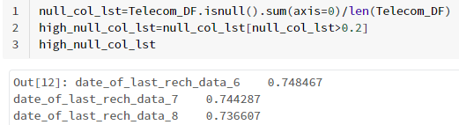
Data pre-processing (1/3)
Converted all FLOATS to 2 decimal values
Converted Date OBJECT columns to DATETIME
Identified High Null value (>20%) columns
For identified continuous columns
NUMBER columns – Replaced null with ‘0’
CATEGORICAL columns – Replaced null with ‘NA’
Dropped high null value Date columns

Slide 8
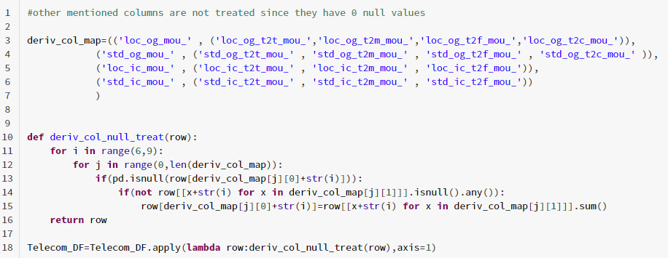
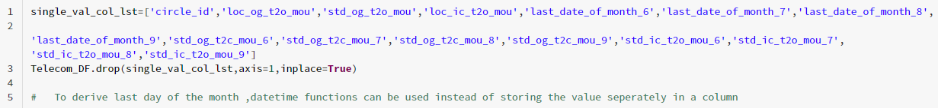
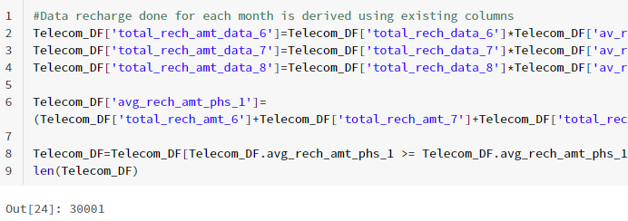
Data pre-processing (2/3)
Null value treatment for derived columns
Identified & dropped columns with nil variance
Identified High Value Customer (30,001) based on 70 percentile of avg. recharge amt.

Slide 9
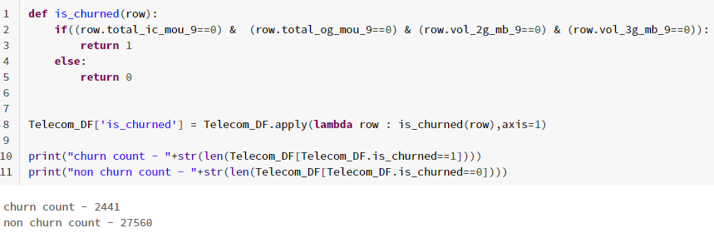



Data pre-processing (3/3)
Identified churn count for 9th month (churn phase)
Churn out = 2441
Non churn out = 27560
9th month columns nos. = 51
Other columns = 159
Identified & dropped null value rows (nos. 1,838)
Exported remaining non-null rows (nos. 28,163)

Slide 10
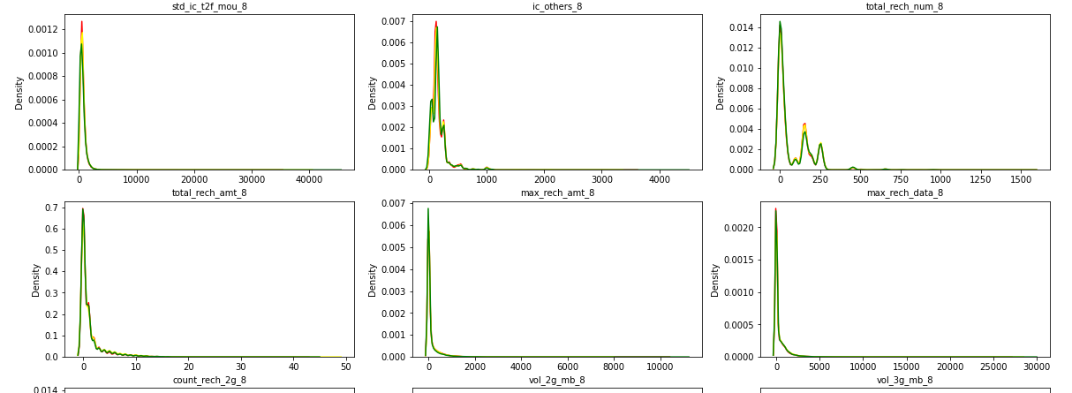
Exploratory Data Analysis (1/3)
Univariate analysis (Hist. plot) – Data dist. for each month is following similar pattern

Slide 11
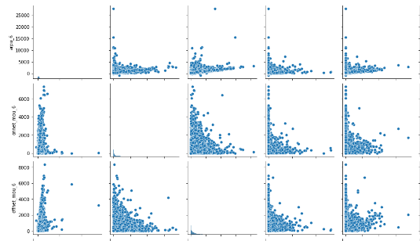
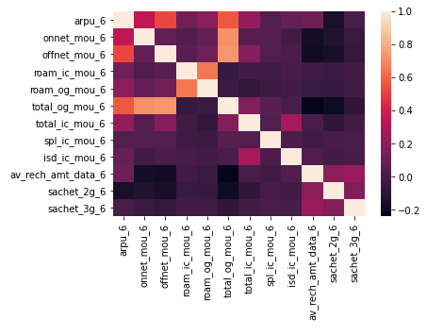
Exploratory Data Analysis (2/3)
Bivariate analysis (Pair plot) – Correlation between variables
Bivariate analysis (Heat-map) – Magnitude of correlation between variables

Slide 12
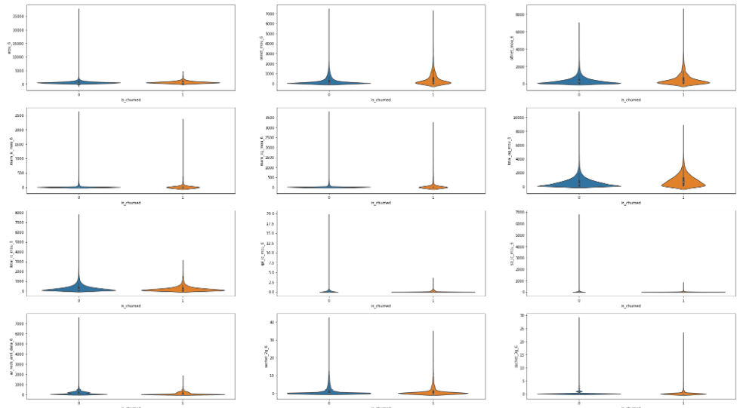
Exploratory Data Analysis (3/3)
Bivariate analysis (Violin plot) – Data class is balanced

Slide 13
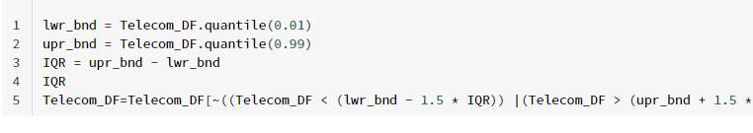
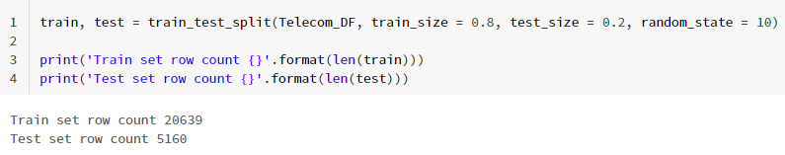
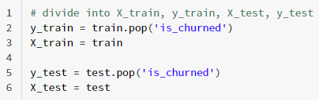

Data modelling
Treated dataset for outliers (0.01-0.99 quantile)
Defining target column
Split dataset into test (nos. 20,639) & train (nos. 5,160)
Separated target column
Scaled the variables

Slide 14
Tasks – Auto ML
Storage – Azure Data Lake
Storage – Azure Data Lake
Model training – Azure ML
Data processing – Azure Databricks
Model validation & Evaluation– Azure ML
Result visualization – Azure ML
Best model selection – Azure ML
Deploy model as Web App – Azure ML
Data visualisation– Azure Databricks
Manual model building & prediction – Azure Databricks
Manual ML
Auto ML

Slide 15
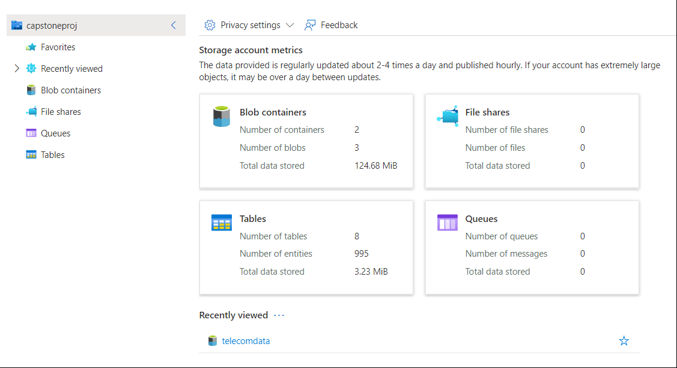
Storage – Azure Data Lake
Ingested .csv file into the Azure Data Lake

Slide 16
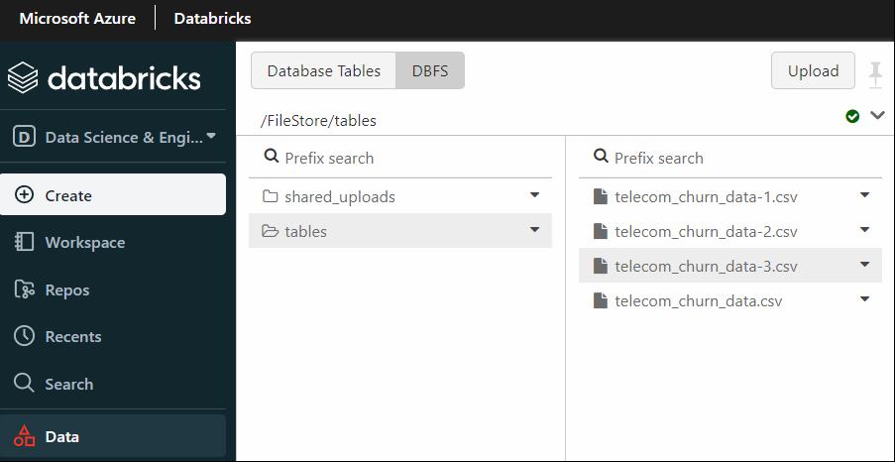
Data processing – Azure Databricks
Data imported into into the Azure Databricks

Slide 17
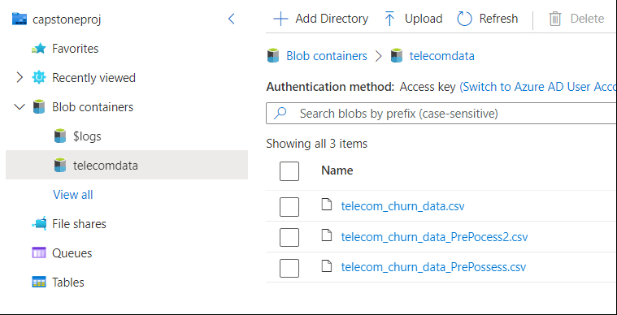
Storage – Azure Data Lake
Pre-processed .csv file stored exported into Azure Data Lake

Slide 18
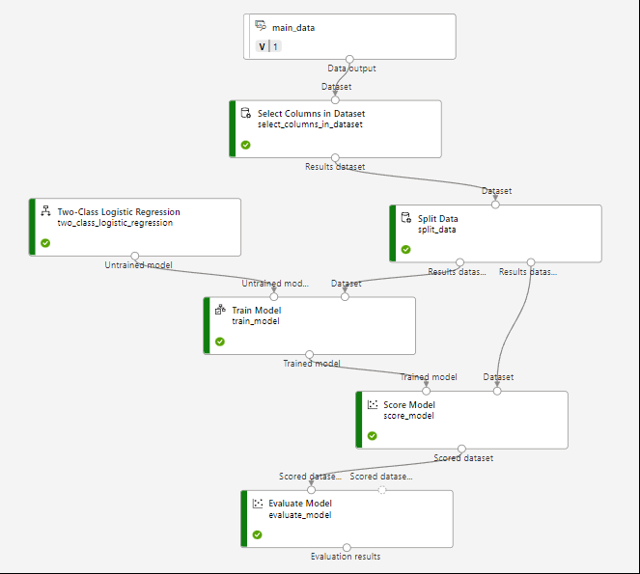
Model training – Azure ML
Auto ML model pipeline created in Azure ML

Slide 19
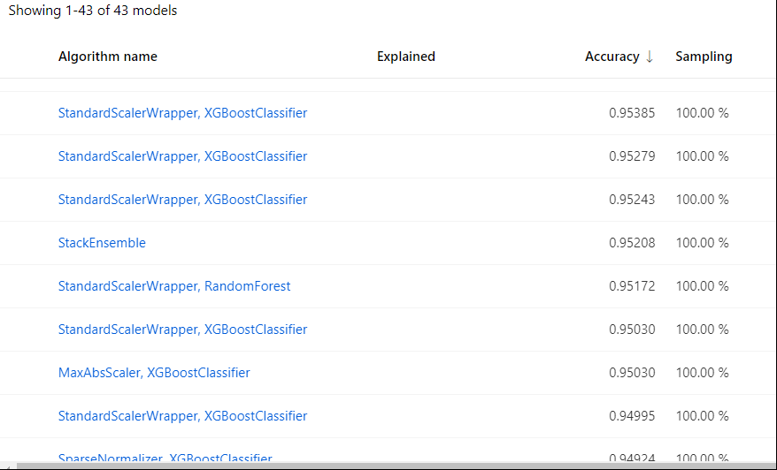
Best model selection
XGBoost classifier provides best prediction accuracy

Slide 20
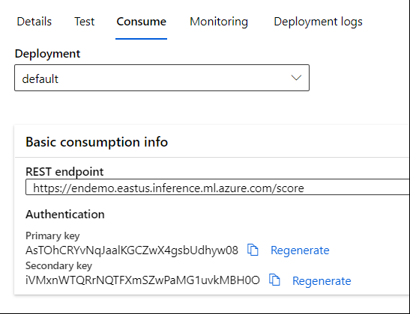
Deploy model as Web App
Model deployed as a web service

Slide 21
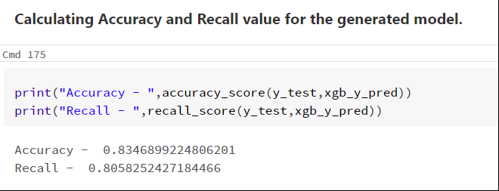
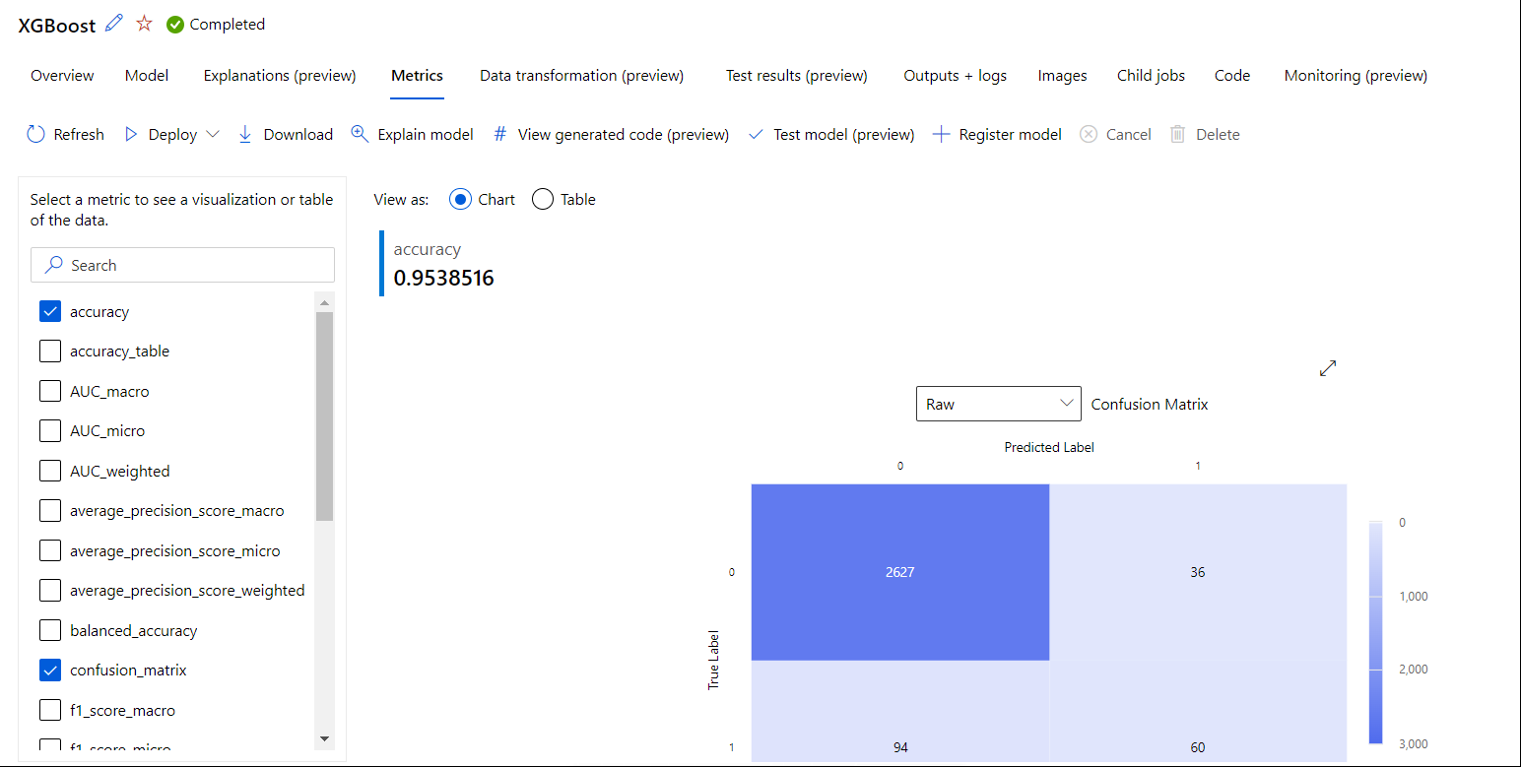
Results (1/3)
XG Boost algorithm prediction

Slide 22
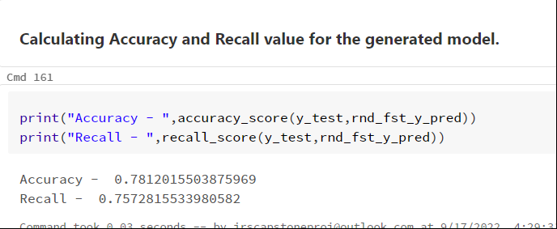
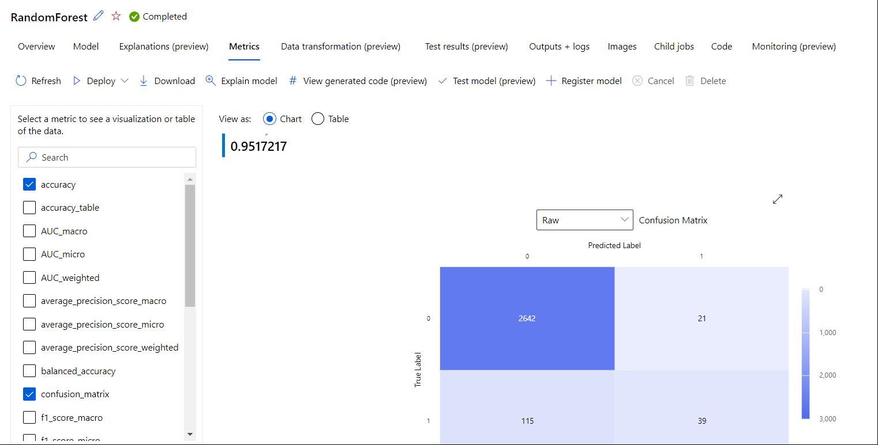
Results (2/3)
Random Forest algorithm prediction

Slide 23
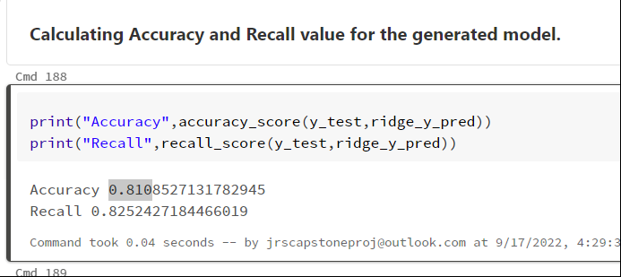
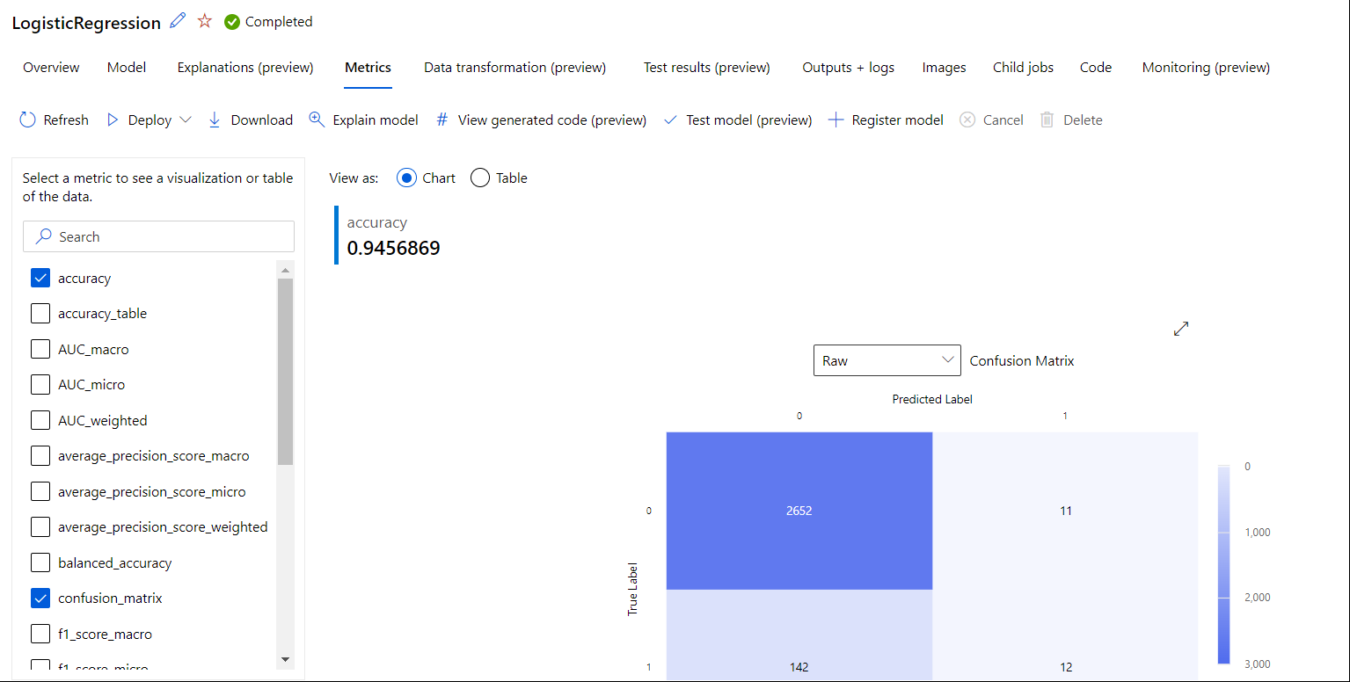
Results (3/3)
Logistic Regression algorithm prediction

Slide 24
Discussions
Comparison of manual and auto-ML prediction accuracies
Algorithm employed | Manual prediction accuracy | Auto ML prediction accuracy
XGBoost Classifier | 0.834 | 0.953
Random Forest | 0.781 | 0.951
Logistic Regression | 0.810 | 0.945

Slide 25
Thank you

